Slide 1

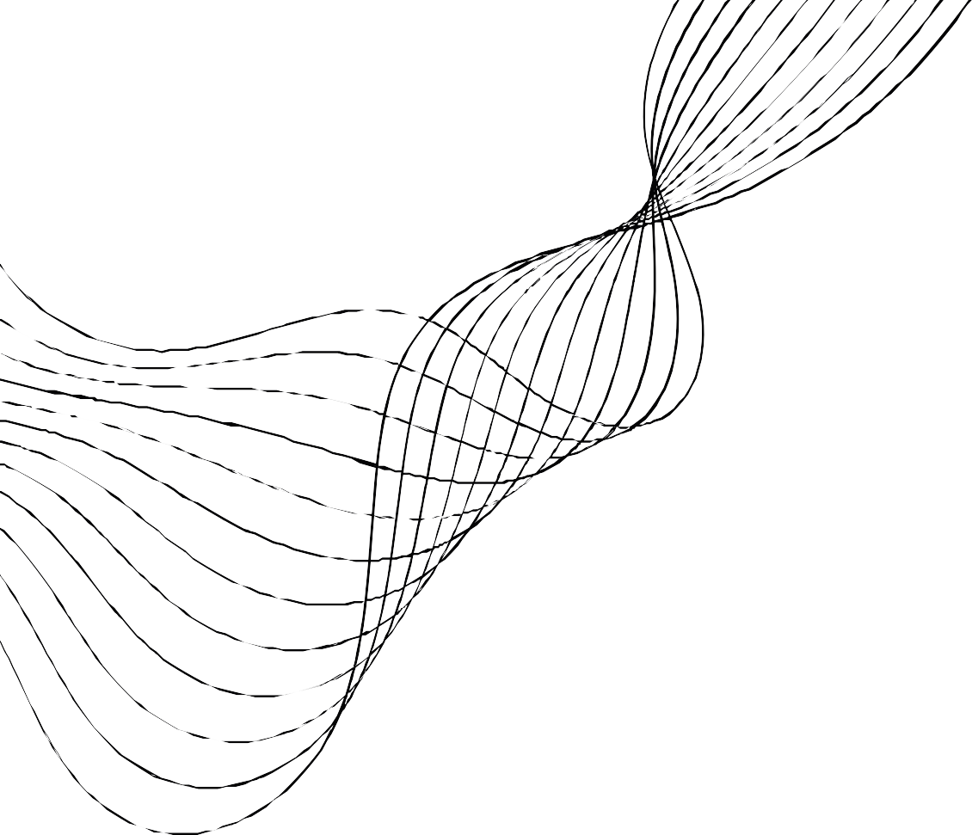


Phishing Website Detection
Student – Rajvardhan Deshmukh(33224)
Guide- Mr. Tushar A. Rane
Reviewer- Mrs. Jayashree Jagdale

Slide 2
INTRODUCTION
Phishing Websites:
Phishing websites are fraudulent sites that imitate legitimate ones to trick users into providing sensitive information, such as passwords or credit card details. These sites are commonly used in cyberattacks, leading to identity theft, financial fraud, and malware distribution. As one of the most prevalent cyber threats, phishing has a significant impact on cybersecurity, resulting in billions of dollars in losses worldwide.
Role of Machine Learning:
Developing automated phishing detection systems is crucial in mitigating these attacks. Traditional methods, which rely on predefined rules, are insufficient to handle the increasing volume and sophistication of phishing schemes. Machine learning plays a pivotal role in automating phishing detection by identifying patterns and anomalies in website features. By learning from large datasets, machine learning models can adapt to new phishing techniques, providing more accurate and scalable solutions compared to manual detection methods.

Slide 3

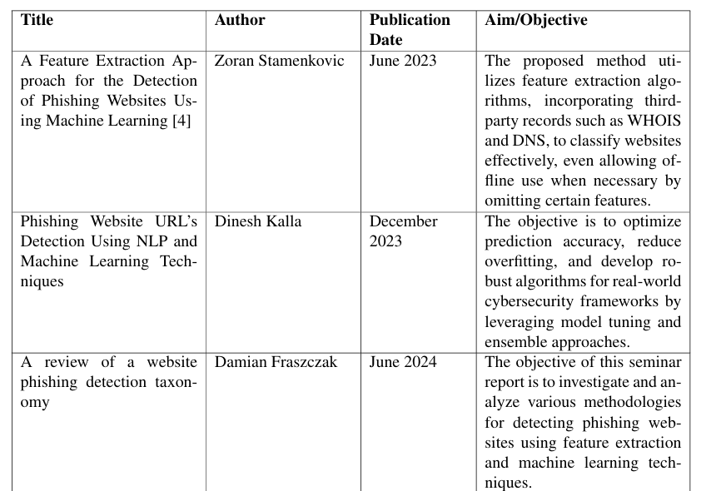

LITERATURE SURVEY

Slide 4
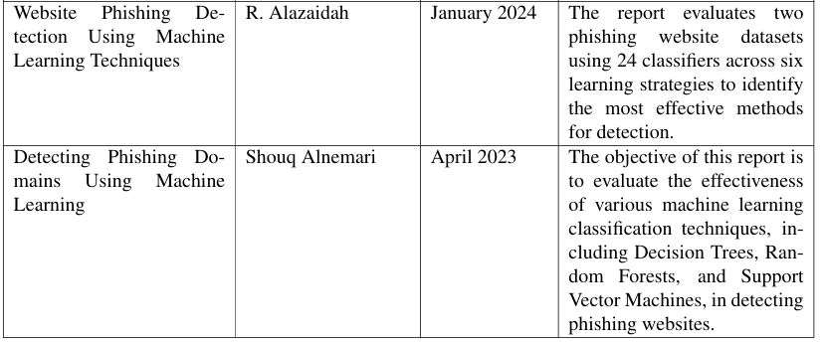
LITERATURE SURVEY

Slide 5
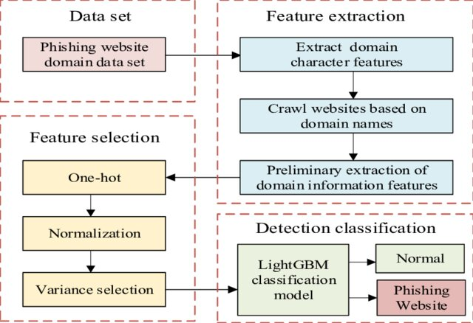
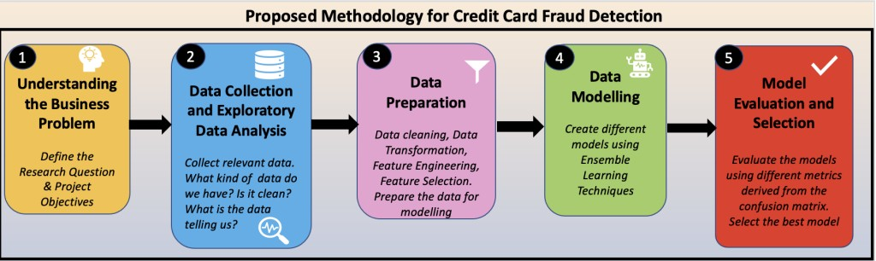
PROPOSED ARCHITECTURE
PROPOSED METHODOLOGY

Slide 6
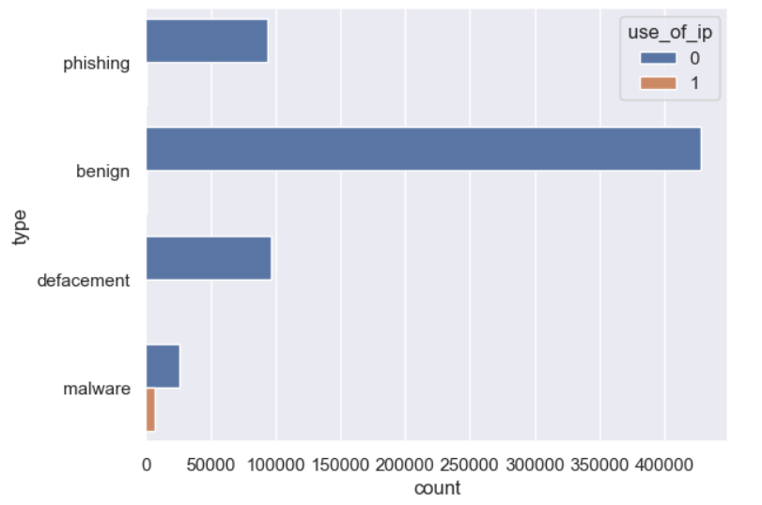
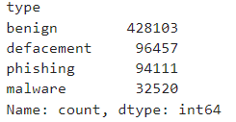
DATASET STUDY
Shape of dataset:( 6,51,191) No missing values
Have implemented PCA no need to implement outliers treatment
Maleware urls are concentrated in the lower amount range, while benign urls are spread across high amounts.
Only the Amount column was scaled, as the other features are PCA transformed
Oversampling the minority class (e.g., SMOTE - Synthetic Minority Over-
sampling Technique) needs to be applied
Dataset:
https://www.kaggle.com/datasets/sid321axn/malicious-urls-dataset

Slide 7
METHODLOGY
Data Preprocessing:
Cleanse data: Handle missing values, outliers, inconsistencies.
Extract features: Extract meaningful patterns (e.g., length of url).
Normalize data: Scale features for consistent range.
Data Distribution Analysis
Analyzing the distribution of phishing and legitimate websites helps identify patterns and anomalies, guiding feature selection for accurate predictions. Visualization methods like his to grams and scatter plots are utilized for clearer insights into the dataset’s structure and feature significance
Machine Learning Algorithms:
XGBoost: Powerful, often top performer, requires tuning
Random Forest: Multiple trees for better accuracy, reduced overfitting.
LightGBM:A highly efficient gradient boosting algorithm , offers faster training times

Slide 8
Model Evaluation Metrics
Beyond accuracy: Consider imbalanced data.
Precision vs. recall: Focus on catching phishing urls Confusion matrix: Detailed performance breakdown. ROC-AUC curve: Overall model performance.
Cross-Validation
Evaluate model performance: Split data into folds, train on most, test on one. Robust evaluation: Average performance across folds for reliable results.
Feature Importance
Feature importance: Identify key factors driving predictions. SHAP values: Explain individual predictions based on features.

Slide 9
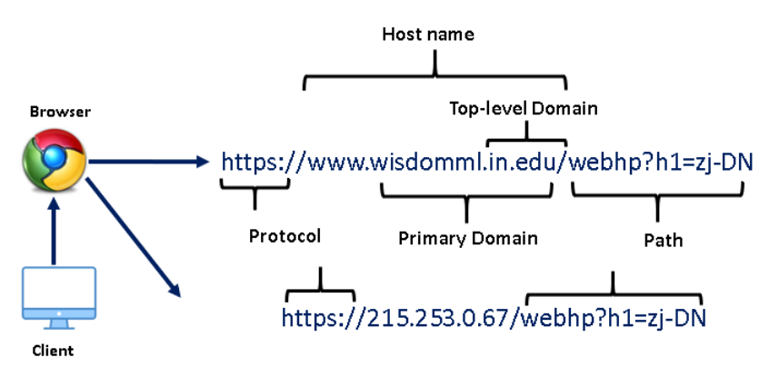
IMPLEMENTATION
What is URL?
The Uniform Resource Locator (URL) is the well-defined structured format unique address for accessing websites over World Wide Web (WWW).
Generally, there are three basic components that make up a legitimate URL
i.) Protocol: It is basically an identifier that determines what protocol to use e.g., HTTP, HTTPS, etc.
ii) Hostname: Also known as the resource name. It contains the IP address or the domain name where the actual resource is located.
iii) Path: It specifies the actual path where the resource is located

Slide 10
IMPLEMENTATION
Feature engineering
In this step, we will extract the following lexical features from raw URLs, as these features will be used as the input features for training the machine learning model. The following features are created as follows:
having_ip_address: Generally cyber attackers use an IP address in place of the domain name to hide the identity of the website. this feature will check whether the URL has IP address or not.
abnormal_url: This feature can be extracted from the WHOIS database. For a legitimate website, identity is typically part of its URL.
google_index: In this feature, we check whether the URL is indexed in google search console or not.
Count. : The phishing or malware websites generally use more than two sub-domains in the URL. Each domain is separated by dot (.). If any URL contains more than three dots(.), then it increases the probability of a malicious site.
Count-www: Generally most of the safe websites have one www in its URL. This feature helps in detecting malicious websites if the URL has no or more than one www in its URL.
count@: The presence of the “@” symbol in the URL ignores everything previous to it.
Count_dir: The presence of multiple directories in the URL generally indicates suspicious websites.
Count_embed_domain: The number of the embedded domains can be helpful in detecting malicious URLs. It can be done by checking the occurrence of “//” in the URL.

Slide 11
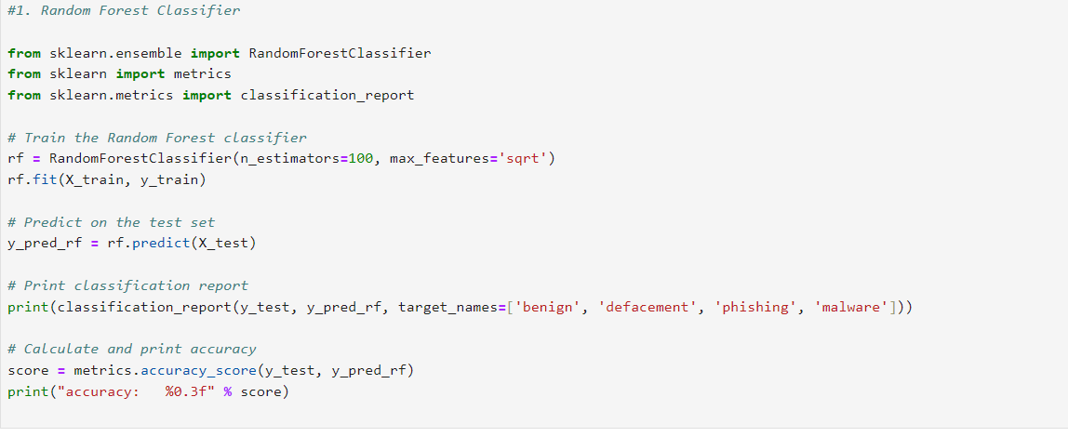
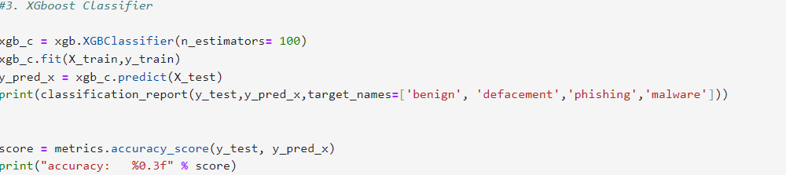
IMPLEMENTATION

Slide 12
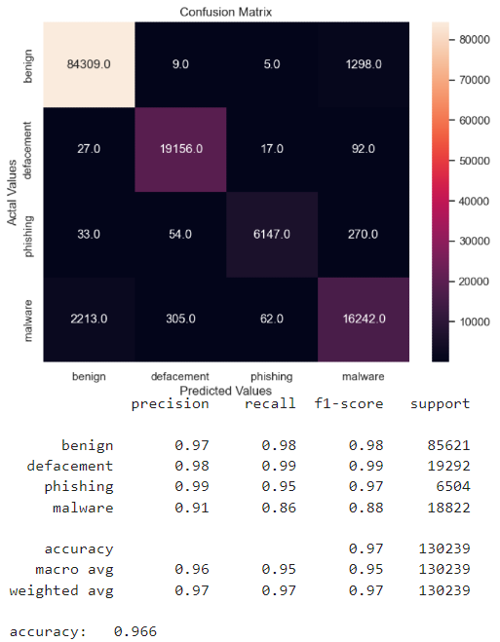
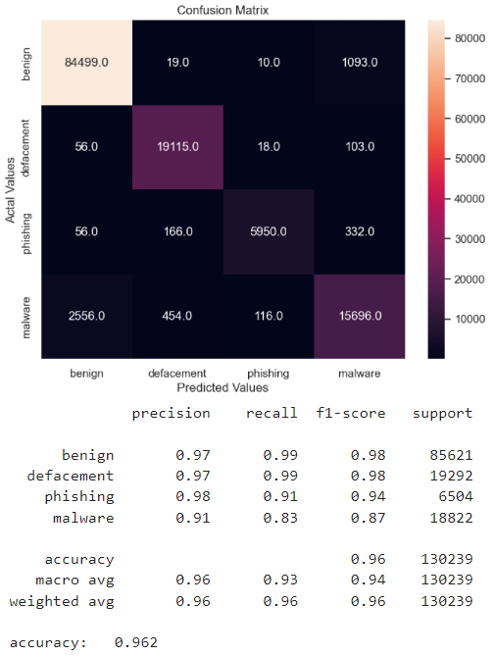
RESULTS
RANDOM FOREST
XG BOOST

Slide 13

Light GBM

Slide 14
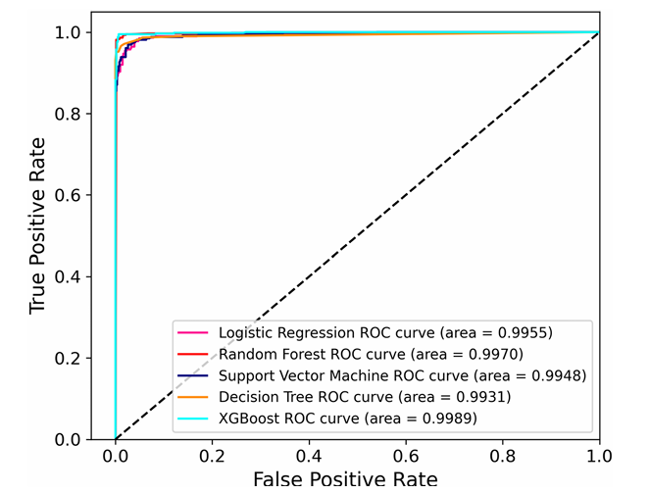
COMPARATIVE ANALYSIS
COMPARATIVE- ROC

Slide 15
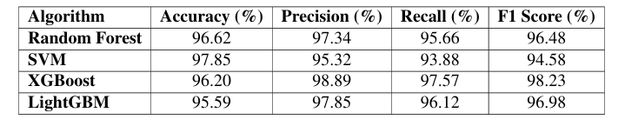
COMPARISION OF ALGORITHMS

Slide 16


Probable Application
01 02 03 04
Browser-based Phishing Detection Extensions:
Integrating phishing detection algorithms directly into web browsers to warn users before visiting malicious sites.
AI-powered Anti-phishing Gateways:
Developing AI-based security gateways that monitor network traffic and block access to phishing websites in real-time.
Banking and Financial Security Systems:
Phishing detection modules integrated into online banking platforms to verify the authenticity of websites and prevent users from entering sensitive information on phishing websites.
Mobile Application
Security:
Implementing phishing detection within mobile apps to alert users of suspicious URLs accessed through SMS or social media platforms.

Slide 17

Probable BE Problem statement
Automated Phishing Email Classification System:
Build a machine learning-based email classification system that can detect phishing emails by analyzing their metadata, subject lines, and content using feature extraction techniques.
Phishing Detection via Blockchain and Machine Learning:
Integrate blockchain technology with machine learning to create a decentralized phishing detection network, allowing for faster and more transparent takedown processe
Dynamic Phishing Detection for Mobile Applications:
Develop a dynamic phishing detection system for mobile devices that monitors SMS and web interactions, analyzing URLs and app behaviors to prevent phishing attacks.
Phishing Detection Using Deep Learning and NLP:
Developing a deep learning-based phishing detection system that uses Natural Language Processing (NLP) to analyze website content and identify phishing attempts.

Slide 18


CONCLUSION
In conclusion, this study presented a machine learning-based framework for phishing website detection, emphasizing the importance of feature extraction techniques and algorithmic comparisons. By analyzing features such as URL patterns, domain age, and HTTPS usage, the proposed solution significantly improves detection accuracy. Our results show that machine learning models, particularly XGBoost and Random Forest, outperform traditional methods in identifying phishing attempts. This approach enhances cybersecurity measures and contributes to building user trust in online transactions, highlighting the potential for further advancements in phishing detection systems.

Slide 19


REFRENCES
Dinesh Kalla1 and Sivaraju Kuraku (2023) Phishing Website URL’s Detection Using NLP and Machine Learning TechniquesResearchGat
Sri Charan Gundla,M.Praveen Karthik (2024) A Feature Extraction Approach for the De tection of Phishing Websites Using Machine Learning. ResearchGate
R. Alazaidah1, A. Al-Shaikh, M. R. AL-Mousa, H. Khafajah (2024) Website Phishing De tection Using Machine Learning Techniques. Journal of Statistics Applications Probability
Jayesh Soni, Nagarajan Prabakar, Himanshu Upadhyay (2024) PhisNet: Deep learning based Hybrid and Ensemble Multi-level Approach for the detection of phishing websites. ResearchSquare
Shouq Alnemari and Majid Alshammari (2023) Detecting Phishing Domains Using Machine Learning. Applied Sciences

Slide 20

THANK YOU

